Slide 1
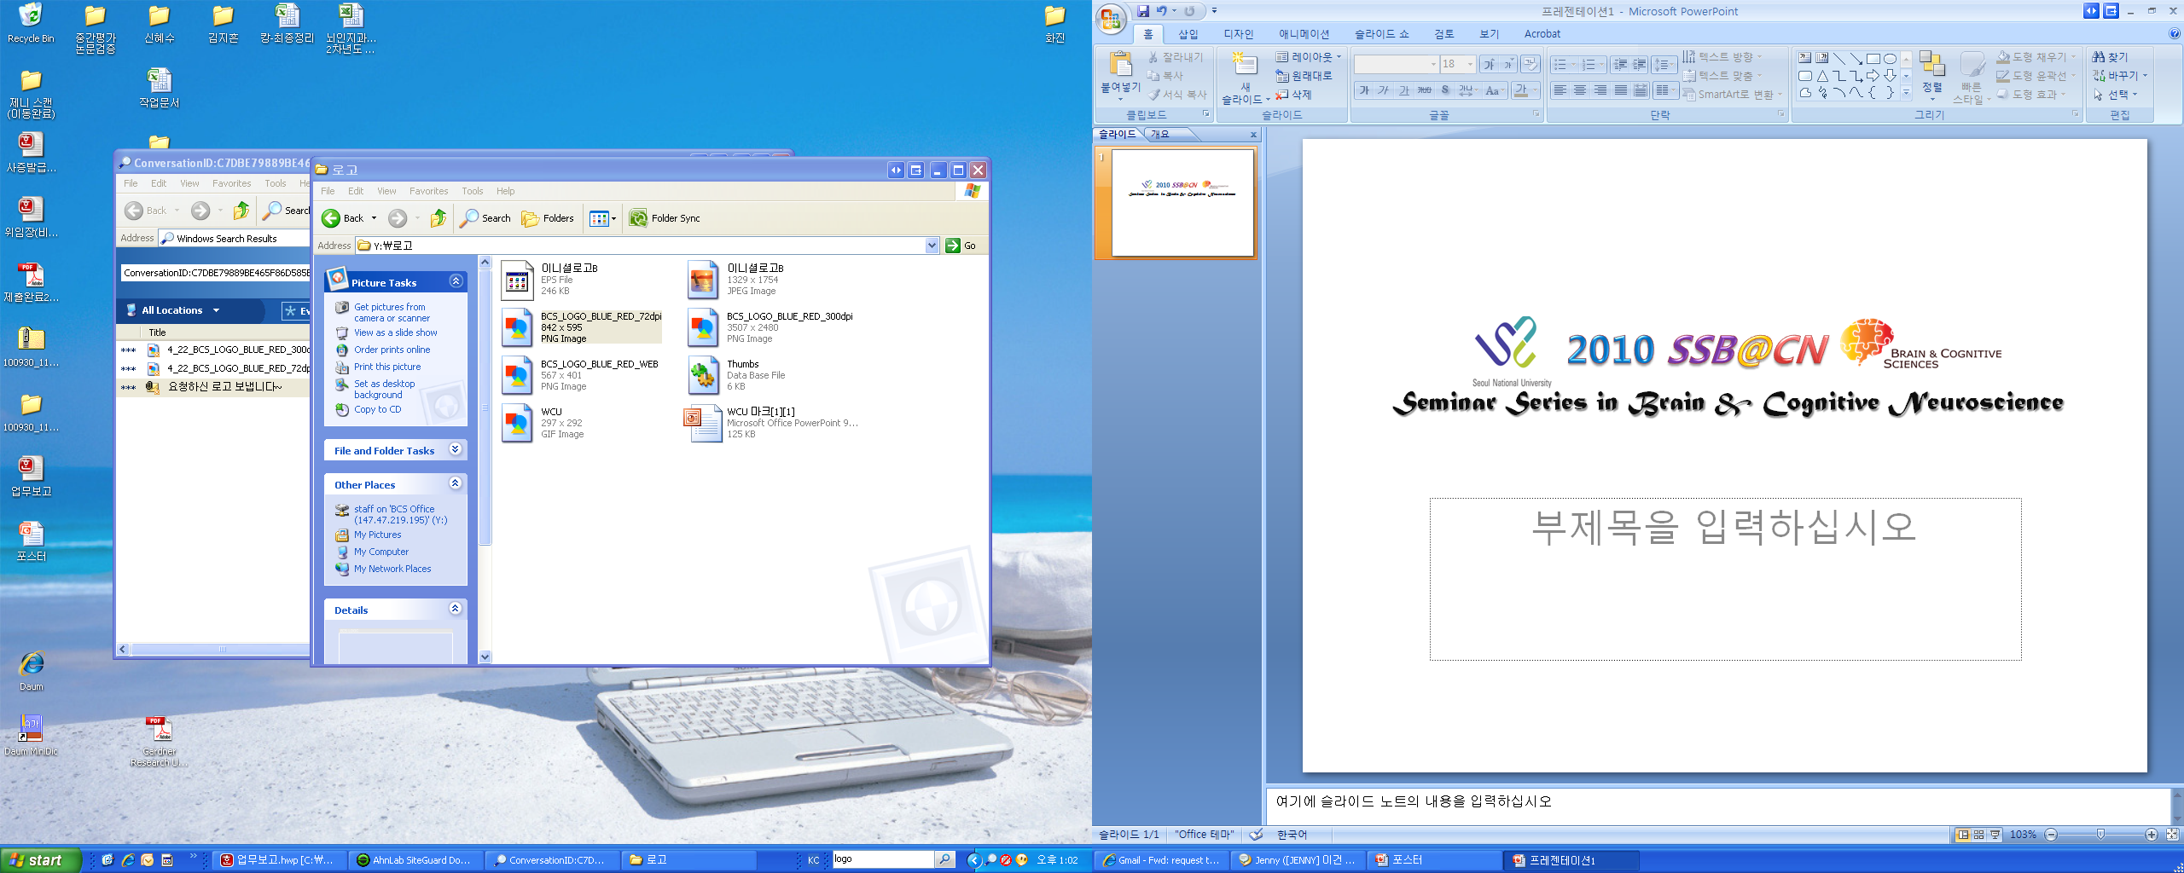
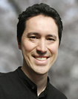
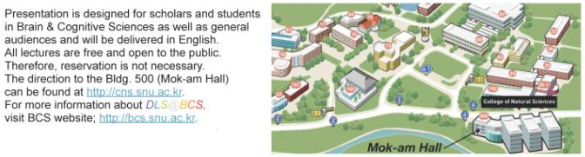
4:00 PM, Thursday, October 21, 2010
Mok-am Hall, Bldg. 501
Human visual perception and fMRI
We are currently hiring a post-doctoral position (short term 6-12 month internships are also possible) in the
Gardner Research Unit at the RIKEN Brain Science Institute.
We are looking for highly motivated scientists who are interested in studying visual perception with a
Combination of functional MRI techniques and psychophysics. Candidates should have, or be expecting
to receive, a PhD in neuroscience, bioengineering, or related fields. A
strong training in experimental methodology (not necessarily fMRI and psychophysics – for example,
single-unit neurophysiology is appropriate) with solid quantitative skills is required. Seminars and
daily scientific activities at the RIKEN Brain Science Institute are all conducted in English. Non-Japanese
applicants may apply for on-campus housing for their first year. RIKEN is located in Wako, Japan
which is a 12 minute train ride from central Tokyo.
For inquiries, send a brief cover letter stating your research interests, your CV and contact information
for two scientist who can act as references to Justin L. Gardner at gru@brain.riken.jp
Justin L. Gardner, PhD
Gardner Research Unit Leader, RIKEN Brain Science Institute
Academic Background : Yale University New Haven, CT, University of California, Berkeley UCSF Berkeley and San Francisco, CA
Fellowships and Awards: Tau Beta Pi national engineering honor society 1993
B.S. in Computer Science awarded Cum Laude with Distinction in the major 1993
National Science Foundation Graduate Research Fellowship 1996-1999
Burroughs Wellcome Fund Fellowship in Quantitative Biology 2001-2002
Japan Society for the Promotion of Science (JSPS) Fellow 2002-2004
NRSA from the National Eye Institute 2004-2007
Burroughs Wellcome Fund Career Award in the Biomedical Sciences 2006-2011

Slide 2


Seoul National University
presents
Seminar Series in Brain &
Cognitive Neuroscience
“Human visual perception and fMRI ”
Justin L. Gardner, PhD
Gardner Research Unit Leader, RIKEN Brain Science Institute
Academic Background : Yale University New Haven, CT, University of California, Berkeley UCSF Berkeley and San Francisco, CA
Abstract:
We are currently hiring a post-doctoral position (short term 6-12 month internships are also possible) in the Gardner Research Unit at the RIKEN Brain Science Institute.
We are looking for highly motivated scientists who are interested in studying visual perception with a
Combination of functional MRI techniques and psychophysics. Candidates should have, or be expecting
to receive, a PhD in neuroscience, bioengineering, or related fields. A
strong training in experimental methodology (not necessarily fMRI and psychophysics – for example,
single-unit neurophysiology is appropriate) with solid quantitative skills is required. Seminars and
daily scientific activities at the RIKEN Brain Science Institute are all conducted in English. Non-Japanese
applicants may apply for on-campus housing for their first year. RIKEN is located in Wako, Japan
which is a 12 minute train ride from central Tokyo.
For inquiries, send a brief cover letter stating your research interests, your CV and contact information
for two scientist who can act as references to Justin L. Gardner at gru@brain.riken.jp
◈ Date & Time : October 21th (Thur.) 16:00~17:30
◈ Place & Map : Mok-am Hall, Bldg. 501
For further information, please contact:
BCS Supporting Team (☏ 02-880-9108), esther0319@snu.ac.kr
(☏ 02-880-8011), shinheasoo @snu.ac.kr

