Slide 1
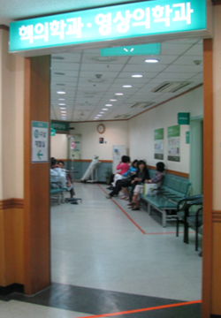
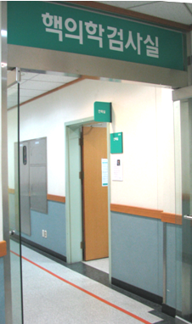
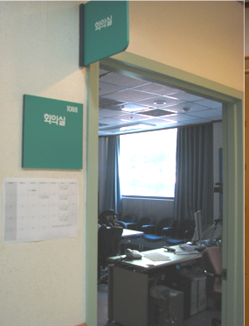


Brain & Cognitive Sciences New Student Orientation
How to Get to the OT Meeting Point
1st Floor Lobby, SNU Hospital Department of Nuclear Medicine
Conference Room 1088 (at the end of the hall way)

